Slide 1
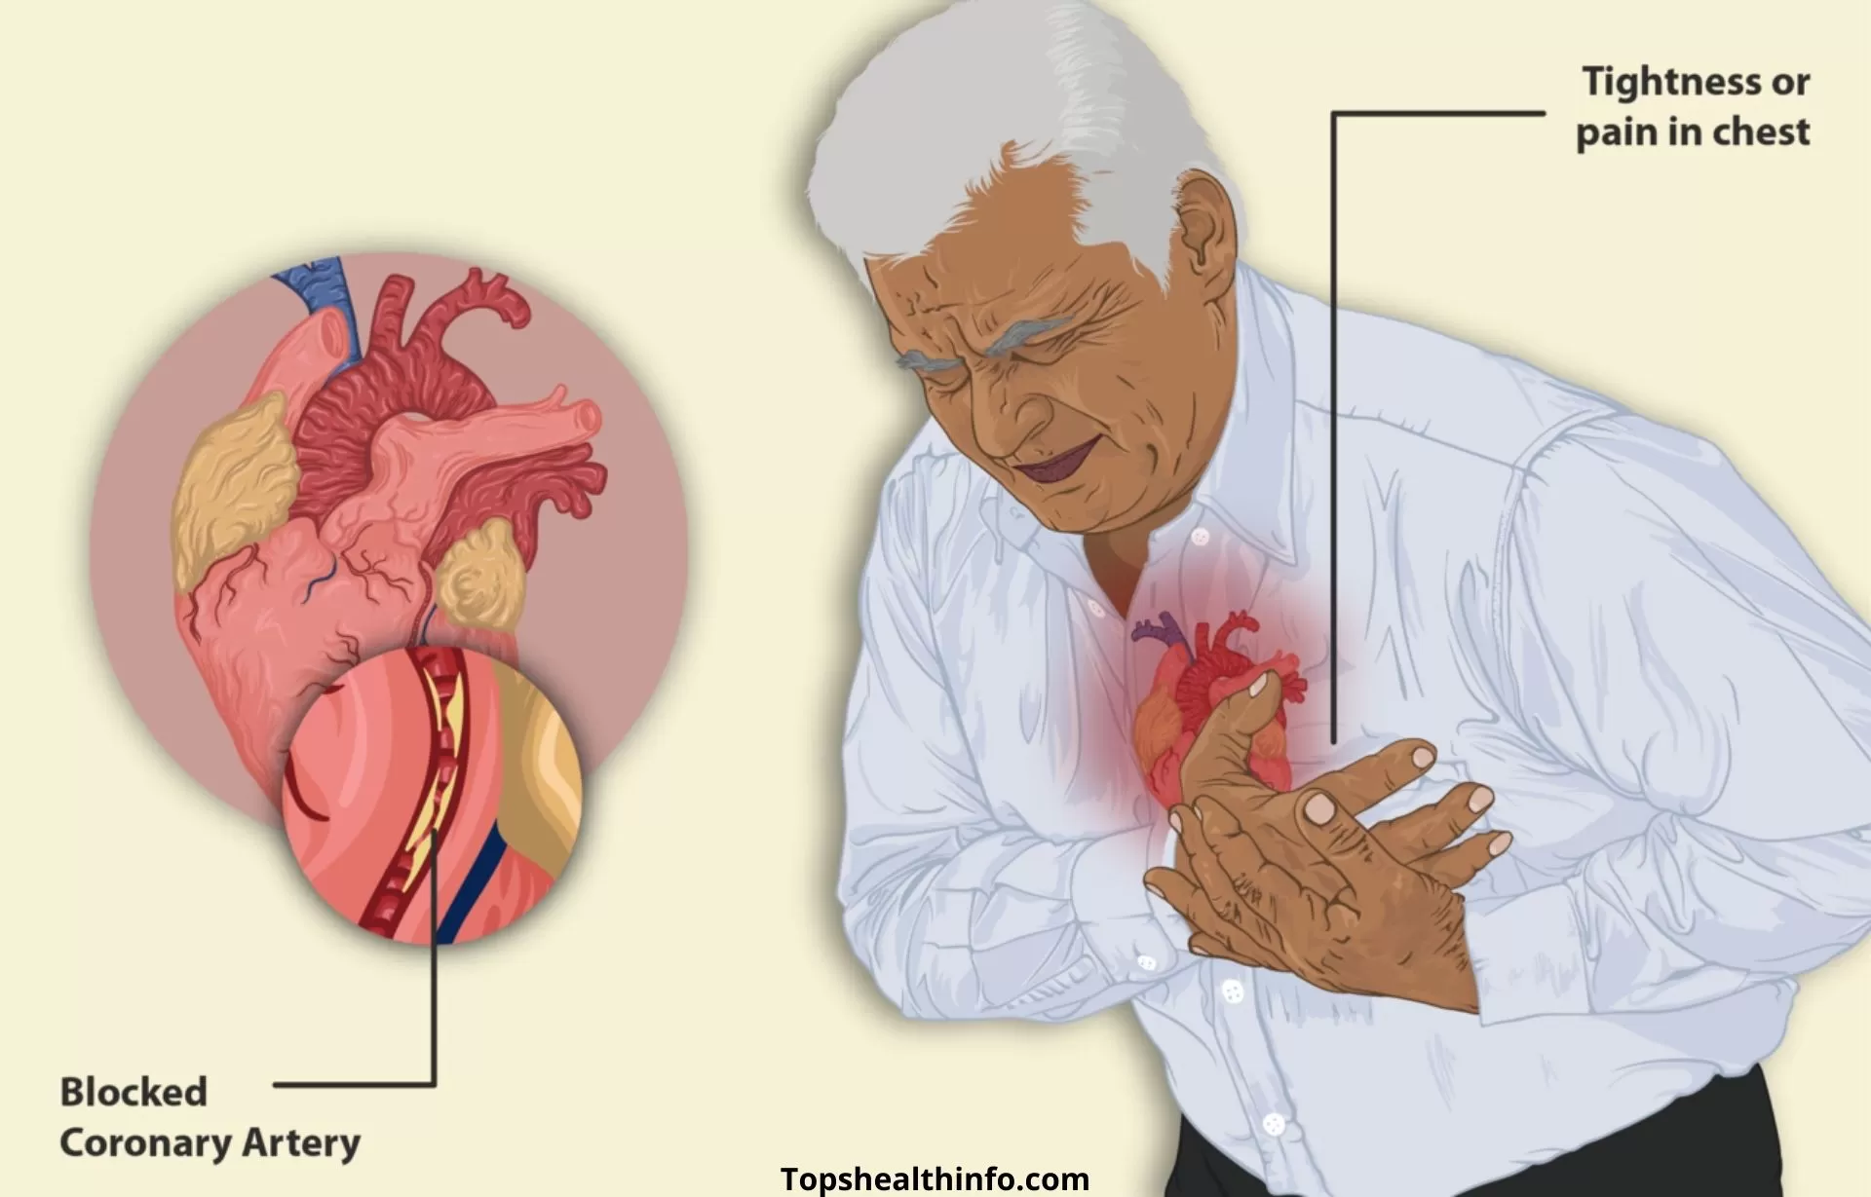
Antianginal Drugs

Slide 2
Angina Pectoris
Atherosclerotic disease of coronary arteries is the most common cause of mortality
Imbalance in myocardial oxygen supply & demand
Stable angina: effort-induced, short-lasting, promptly relieved by rest or nitroglycerin
Unstable angina: severe angina ˃20 minutes, not relieved by rest or nitroglycerin. Need hospital.
Prinzmetal, variant, vasospastic angina: spasm of coronary arteries at rest. Promptly relieved by nitroglycerin & calcium channel blockers.

Slide 3
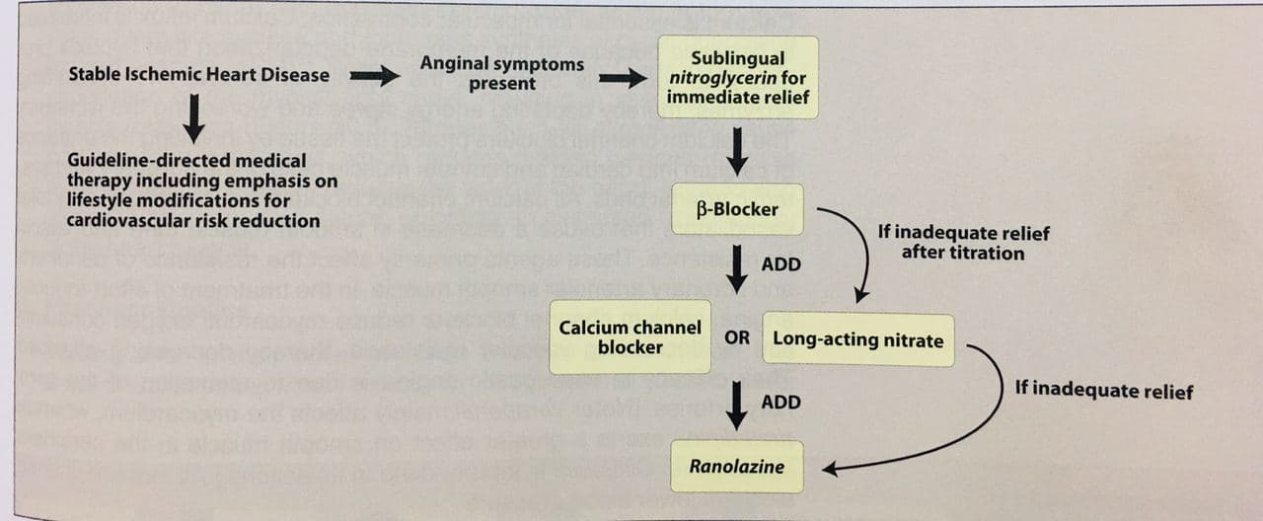
Treatment strategies:
Four types of drugs are commonly used alone or in combination: ß-blockers, calcium channel blockers, organic nitrates, and sodium channel blocker (ranolazine)

Slide 4
β-adrenergic blockers
β-blockers decrease oxygen demands of myocardium by blocking β1 receptors→
↓HR, contractility, COP, & BP.
↑ coronary perfusion time during diastole?
β-blockers are recommended as initial antianginal
But should be avoided in Prinzmetal angina?
β-blockers improve survival in prior MI & HF?
β-blockers with ISA (pindolol) are avoided?
Cardio-selective are preferred?
Avoid abrupt withdrawal? Tapering 2-3 wks

Slide 5
Calcium channel blockers (CCB)
The intracellular concentration of calcium plays an important role in maintaining the tone of smooth muscle and in the contraction of the myocardium.
Calcium channel antagonists block the inward movement of calcium by binding to calcium channels in the heart and in smooth muscle of the coronary and peripheral arteriolar vasculature.
This causes vascular smooth muscle to relax, dilating mainly arterioles.
Calcium channel blockers do not dilate veins.

Slide 6
Calcium channel blockers (CCB)
Calcium is essential for muscular contraction & its influx is increased in ischemia (worse effect).
CCB protect tissues by inhibiting calcium entrance
All CCB are arteriolar & coronary vasodilators→↓resistance & afterload &↓BP
Useful in vaso-spastic angina (coronary vasodilation)
Verapamil mainly on myocardium, amlodipine greatly peripheral. Diltiazem is intermediate

Slide 7
Dihydropyridine CCB
Amlodipine has minimal effect on cardiac conduction
Main function is arteriolar vasodilator
Useful in variant angina
Nifedipine (extended release formulation) Short acting should be avoided in angina (increased mortality?)
All CCBs are useful in the reatment of angina. In addition, nondihydropyridine CCB: diltiazem and verapamil are used in the treatment of atrial fibrillation & supraventricular tachycardia (SVT)

Slide 8
Nondihydropyridine CCB
Verapamil slows atrioventricular (AV) coduction, and decreasing HR, contractility, BP & oxygen demand
Verapamil has greater negative inotropic effects than amlodipine, but weaker vasodilator
Verapamil is contraindicated in HF or AV conduction abnormality & never combined with β-blockers?.
Diltiazem also slows AV conduction & firing of sinus node. It is also coronary vasodilator & is particularly useful for variant angina.

Slide 9
Organic nitrates
Mechanism of action:
Relax vascular smooth ms by release of nitric oxide (NO) by mitochondrial aldehyde dehydrogenase (ALDH).
NO activates guanylate cyclase & ↑ synthesis of cyclic guanosine monophosphate (cGMP)
cGMP →dephosphorylation of myosin light chain, resulting in vasodilation.
Nitrates cause venodilation & reduce preload & then work of the heart
Also dilate coronary vessels, increasing bl. supply

Slide 10
Onset of action
1 minute for sublingual nitroglycerin (tablet or spray)
30 min. for transdermal (patch or ointment) nitroglycerine or sustained release tablets of isosorbide mononitrate or dinitrate.
Nitroglycerin (GTN, Angised) exposed to significant first pass metabolism in the liver
Adverse effects:
Throbbing headache is the most common (meningeal vasdilation).
Postural hypotension, facial flushing & reflex tachycardia
Nitrate tolerance

Slide 11
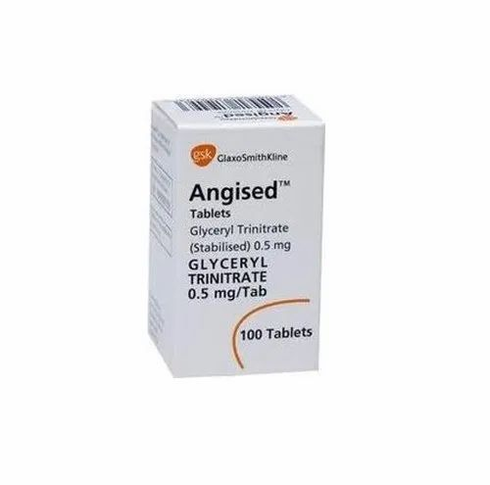
Nitroglycerin (GTN, Angised)

Slide 12
Phosphodiesterase 5 inhibitors (Sildenafil, Viagra) potentiate the nitrate action, causing dangerous hypotention. This combination is contraindicated
Tolerance to nitrate action develops rapidly as blood vs. become desensitized to vasodilation. Due to oxidation of mitochondrial ALDH enzyme by NO.
Nitrate-free interval to restore sensitivity to nitrate action. 10-12 hrs usually overnight night when oxygen demand is decreased .
Variant angina worsens early morning → late afternoon free interval

Slide 13
Sodium channel blocker
Ranolazine
Inhibits the late phase of sodium current & reduces intracellular Na & Ca. Thereby improving diastolic function & improving oxygen supply & demand.
Used when other antianginals are failed
Numerous drug interactions & can prolong QT interval.

Slide 14
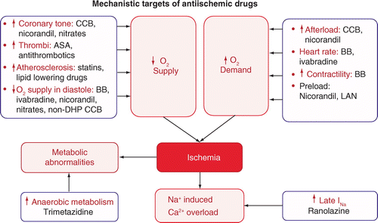
Conclusion

Slide 15
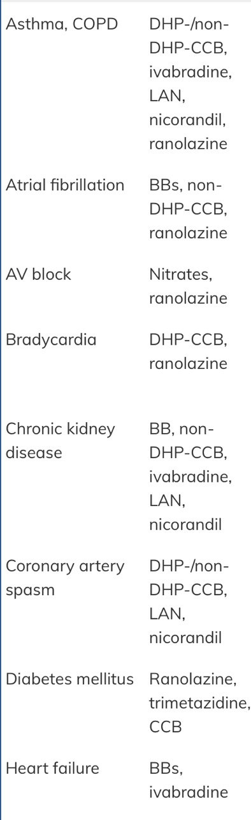
Antianginal in relation to comorbidity

Slide 16
MCQ
Which drug should be prescribed to all angina patients in acute attack?
Isosorbide mononitrate
Isosorbide dinitrate
Nitroglcerin patch
Sublingual nitroglycerin
Ranolazine

Slide 17
MCQ
A 60 year-old man diagnosed as angina. Atenolol & nitroglycerin were prescribed. Which of his current medications should be discontinued?
Aspirin
Lisinopril
Metformin
Amlodipine
Sildenafil (Viagra)

Slide 18
MCQ
Which of the following correctly ranks from most active on myocardium to most peripherally active?
Diltiazem, amlodipine, verapamil
Verapamil, diltiazem, Amlodipine
Nifedipine, verapamil, diltiazem
Amlodipine, diltiazem, verapamil
Diltiazem, verapamil, nifedipine

Slide 19
MCQ
Which is correct regarding antianginal therapy in patient with angina & heart failure?
Metoprolol has been associated with reduced mortality
Amlodipine should be avoided
Pindolol is the preferred β-blocker
Verapamil should be used in patient who can not tolerate β-blockers
Nitrates are contraindicated

Slide 20
MCQ
Fifty year old patient with severe bronchial asthma, developed angina pectoris. The following drug is preferred initial therapy with nitroglycerine for such patient.
Propranolol
Verapamil
Ranolazine
Pindolol

